Slide 1
BUBT BAPS Programming Camp 2025
Introduction to Problem Solving
RakibJoy

Slide 2
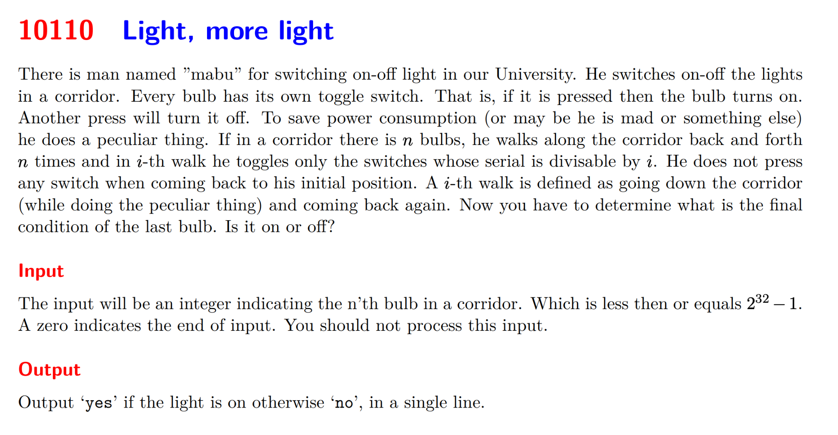

Slide 3
Where we can solve problems?
Online Judges Like:
Codeforces.
Atcoder.
Codechef.
Toph.

Slide 4
What is competitive programming then?

Slide 5
What are the competitions we can participate?
Online contest.
Regular contest in online judges.
Facebook Hacker Cup.
Replay contest of onsite contests.
Onsite Contest.
IUPC.
ICPC.
BDOI.
IOI.
And many other,

Slide 6
Why problem solving and competitive programming?

Slide 7
The importance of honesty
Should we take help from AI in problem solving and during contest?

Slide 8
How can I start doing competitive programming?
Learn a programming language. (C, C++ preferred).
Start solving problems in various online judges.
Don’t rush, believe in continuous growth.
Always try to cross yourself.

Slide 9
How to attack a problem?
Don’t rush, read the problem statement carefully.
Read the constraints. ( You can get the hint from it)
Read the time and memory limit. (You can get hint from it)
Simplify the problem.
Try to find a solution.
It is ok not jump to code without being 100% sure about the solution.

Slide 10
RECIPE by Arman Ferdous
R - Reduce
E - Extreme Case
C - Contribution Technique
I - Inverse
P - Pattern Finding
E - Escape
More Resources - https://codeforces.com/blog/entry/133289

Slide 11
About team contest/ ICPC style contest.
3 people.
1 team.
5 hours.

Slide 12
ICPC style problems vs CF style problems.

Slide 13
Practice Strategy - Individual.

Slide 14
Practice Strategy - Team

Slide 15
Contest Strategy - Individual
Don’t rush.
It’s ok to skip a problem for later.
Have your custom plan.
Think big, dream big.

Slide 16
Contest Strategy - Team
Strong team strategy and weaker team strategy.
Why you should have your custom strategy.
Decision making during contest.

Slide 17
The importance of upsolving
Should we upsolve after every contest?
How to upsolve?
What to do when we get stuck?
Seeking help from others.

